Slide 1
Introduction to SAX Parser
Lecture : Jackie Stewart
Email : jackiestewart@ait.ie
jackie.stewart@tus.ie

Slide 2
Java SAX Parser
SAX (the Simple API for XML) is an event-based parser for xml documents.
Unlike a DOM parser, a SAX parser creates no parse tree.
SAX is a streaming interface for XML
applications using SAX receive event notifications about the XML document being processed
an element, an attribute, at a time in sequential order starting at the top of the document, and ending with the closing of the ROOT element.

Slide 3
When to use SAX?
You should use a SAX parser when:
You can process the XML document in a linear fashion from the top down
The document is not deeply nested
You are processing a very large XML document whose DOM tree would consume too much memory.
The problem to be solved involves only part of the XML document
Data is available as soon as it is seen by the parser, so SAX works well for an XML document that arrives over a stream

Slide 4
SAX Parsing Disadvantages
We have no random access to an XML document since it is processed in a forward-only manner
If you need to keep track of data the parser has seen or change the order of items, you must write the code and store the data on your own

Slide 5
SAX Interfaces
The SAX defines several Java interfaces. Here are the most common interfaces:
void startDocument()
Called at the beginning of a document.
void endDocument()
Called at the end of a document.
void startElement(String uri, String localName, String qName, Attributes atts)
Called at the beginning of an element.
void endElement(String uri, String localName,String qName)
Called at the end of an element.
void characters(char[] ch, int start, int length)
Called when character data is encountered.

Slide 6
Further SAX Interfaces
void ignorableWhitespace( char[] ch, int start, int length)
Called when a DTD is present and ignorable whitespace is encountered.
void processingInstruction(String target, String data)
Called when a processing instruction is recognized.
void setDocumentLocator(Locator locator))
Provides a Locator that can be used to identify positions in the document.
void skippedEntity(String name)
Called when an unresolved entity is encountered.
void startPrefixMapping(String prefix, String uri)
Called when a new namespace mapping is defined.
void endPrefixMapping(String prefix)
Called when a namespace definition ends its scope.

Slide 7
SAX Attributes Interface
This interface specifies methods for processing the attributes connected to an element.
int getLength() - Returns number of attributes.
String getQName(int index)
String getValue(int index)
String getValue(String qname)often:

Slide 8
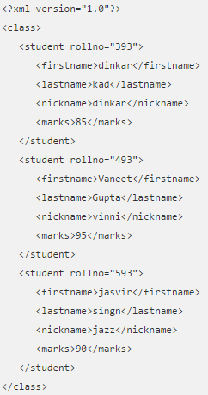
Example Xml
Note: ‘rollno’ is an attribute
Notes:
<?xml version="1.0"?> <class> <student rollno="393"> <firstname>dinkar</firstname> <lastname>kad</lastname> <nickname>dinkar</nickname> <marks>85</marks> </student> <student rollno="493"> <firstname>Vaneet</firstname> <lastname>Gupta</lastname> <nickname>vinni</nickname> <marks>95</marks> </student> <student rollno="593"> <firstname>jasvir</firstname> <lastname>singn</lastname> <nickname>jazz</nickname> <marks>90</marks> </student> </class>

Slide 9
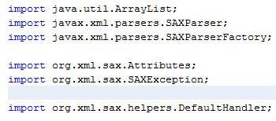
Steps to Using SAX
Following are the steps used while parsing a document using SAX Parser.
Import XML-related packages.

Slide 10
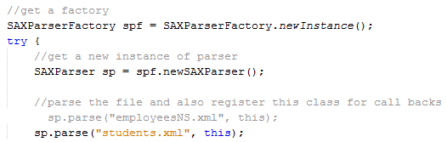
Steps to Using SAX
Following are the steps used while parsing a document using SAX Parser.
Create a SAXParserFactory from a singleton call
Create a SAXParser
Call ‘parse’ method passing in XML file along with ‘callback’ class

Slide 11

Steps to Using SAX
Parser class extends DefaultHandler
This lets us override base methods such as ‘startElement’ etc.
Use a series of true/false values to let us know where we currently are (what tag / line we’re currently on)
Are we currently on bFirstName ? bFirstName = true or false?

Slide 12
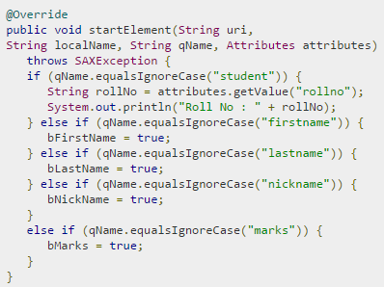
Example SAX Parser (startElement)
startElement:
Is called when ‘parse’ method encounters a ‘start element’
Using a series of if statements we can check to see if start tag is:
firstname ? If so, mark that we are in ‘firstname’ tag
lastname ? If so, mark that we are in ‘lastname’ tag
nickname ? If so, mark that we are in ‘nickname’ tag
marks ? If so, mark that we are in ‘marks’ tag

Slide 13
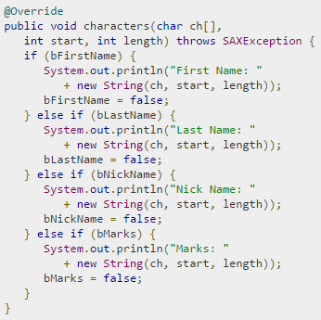
Example SAX Parser (characters)
characters:
Is called when ‘parse’ method encounters a text elements
Using a series of if statements we can check to see if start tag equal to a start element we are looking for :
firstname ? If so, store ‘firstname’ value & set value to false (we are no longer in ‘firstname’)
lastname ? If so, store ‘lastname’ tag value & set value to false
nickname ? If so, store ‘nickname’ tag value & set value to false
marks ? If so, store ‘marks’ tag value & set value to false

Slide 14
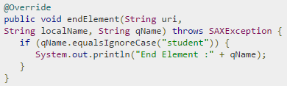
Example SAX Parser (endElement)
endElement:
Is called when ‘parse’ method encounters a ‘end element’
Could use if statements to denote leaving / finished with a particular tag

Slide 15
OUTPUT
Roll No : 393
First Name: dinkar
Last Name: kad
Nick Name: dinkar
Marks: 85
End Element :student
…
Roll No : 493
First Name: Vaneet
Last Name: Gupta
Nick Name: vinni
Marks: 95
End Element :student
…
Roll No : 593
First Name: jasvir
Last Name: singn
Nick Name: jazz
Marks: 90
End Element :student

Slide 16
Code ALT+SHIFT+F will Auto indent in Netbeans
/*
* To change this license header, choose License Headers in Project Properties.
* To change this template file, choose Tools | Templates
* and open the template in the editor.
*/
package myfirstsaxparser;
import java.io.File;
import javax.xml.parsers.SAXParser;
import javax.xml.parsers.SAXParserFactory;
import org.xml.sax.Attributes;
import org.xml.sax.SAXException;
import org.xml.sax.helpers.DefaultHandler;
public class MyFirstSaxParser extends DefaultHandler {
boolean bFirstName = false;
boolean bLastName = false;
boolean bNickName = false;
boolean bMarks = false;
@Override
public void startElement(String uri,
String localName, String qName, Attributes attributes)
throws SAXException {
if (qName.equalsIgnoreCase("student")) {
String rollNo = attributes.getValue("rollno");
System.out.println("Roll No : " + rollNo);
} else if (qName.equalsIgnoreCase("firstname")) {
bFirstName = true;
} else if (qName.equalsIgnoreCase("lastname")) {
bLastName = true;
} else if (qName.equalsIgnoreCase("nickname")) {
bNickName = true;
} else if (qName.equalsIgnoreCase("marks")) {
bMarks = true;
}
}
@Override
public void endElement(String uri,
String localName, String qName) throws SAXException {
if (qName.equalsIgnoreCase("student")) {
System.out.println("End Element :" + qName);
}
}
@Override
public void characters(char ch[],
int start, int length) throws SAXException {
if (bFirstName) {
System.out.println("First Name: "
+ new String(ch, start, length));
bFirstName = false;
} else if (bLastName) {
System.out.println("Last Name: "
+ new String(ch, start, length));
bLastName = false;
} else if (bNickName) {
System.out.println("Nick Name: "
+ new String(ch, start, length));
bNickName = false;
} else if (bMarks) {
System.out.println("Marks: "
+ new String(ch, start, length));
bMarks = false;
}
}
public static void main(String[] args) {
try {
File inputFile = new File("input.xml");
SAXParserFactory factory = SAXParserFactory.newInstance();
SAXParser saxParser = factory.newSAXParser();
MyFirstSaxParser myFirstSaxParser = new MyFirstSaxParser();
System.out.println("myfirstsaxparser.MyFirstSaxParser.main()");
saxParser.parse(inputFile, myFirstSaxParser);
} catch (Exception e) {
e.printStackTrace();
}
}
}
Notes:
/ * To change this license header, choose License Headers in Project Properties.
* To change this template file, choose Tools | Templates
* and open the template in the editor.
*/
package myfirstsaxparser;
import java.io.File;
import javax.xml.parsers.SAXParser;
import javax.xml.parsers.SAXParserFactory;
import org.xml.sax.Attributes;
import org.xml.sax.SAXException;
import org.xml.sax.helpers.DefaultHandler;
public class MyFirstSaxParser extends DefaultHandler {
boolean bFirstName = false;
boolean bLastName = false;
boolean bNickName = false;
boolean bMarks = false;
@Override
public void startElement(String uri,
String localName, String qName, Attributes attributes)
throws SAXException {
if (qName.equalsIgnoreCase("student")) {
String rollNo = attributes.getValue("rollno");
System.out.println("Roll No : " + rollNo);
} else if (qName.equalsIgnoreCase("firstname")) {
bFirstName = true;
} else if (qName.equalsIgnoreCase("lastname")) {
bLastName = true;
} else if (qName.equalsIgnoreCase("nickname")) {
bNickName = true;
} else if (qName.equalsIgnoreCase("marks")) {
bMarks = true;
}
}
@Override
public void endElement(String uri,
String localName, String qName) throws SAXException {
if (qName.equalsIgnoreCase("student")) {
System.out.println("End Element :" + qName);
}
}
@Override
public void characters(char ch[],
int start, int length) throws SAXException {
if (bFirstName) {
System.out.println("First Name: "
+ new String(ch, start, length));
bFirstName = false;
} else if (bLastName) {
System.out.println("Last Name: "
+ new String(ch, start, length));
bLastName = false;
} else if (bNickName) {
System.out.println("Nick Name: "
+ new String(ch, start, length));
bNickName = false;
} else if (bMarks) {
System.out.println("Marks: "
+ new String(ch, start, length));
bMarks = false;
}
}
public static void main(String[] args) {
try {
File inputFile = new File("input.xml");
SAXParserFactory factory = SAXParserFactory.newInstance();
SAXParser saxParser = factory.newSAXParser();
MyFirstSaxParser myFirstSaxParser = new MyFirstSaxParser();
System.out.println("myfirstsaxparser.MyFirstSaxParser.main()");
saxParser.parse(inputFile, myFirstSaxParser);
} catch (Exception e) {
e.printStackTrace();
}
}
}

